Slide 1
Predictive Maintenance & AI Anomaly Detection
End-to-End Industrial IoT Monitoring & HITL Dashboard

Slide 2
The Challenge
Unplanned machine downtime causes high operational costs.
Manual monitoring of sensor data is slow and error-prone.
Lack of integration between automated detection and human expertise. Visual: Icon of machines with warning signs.

Slide 3
Our Solution
Real-time sensor data collection.
AI/ML models detect anomalies automatically.
Human-in-the-loop dashboard validates alerts.
Feedback loop stores decisions for continuous improvement. Visual: High-level pipeline: Sensors → AI → HITL Dashboard → Backend Storage → Feedback

Slide 4
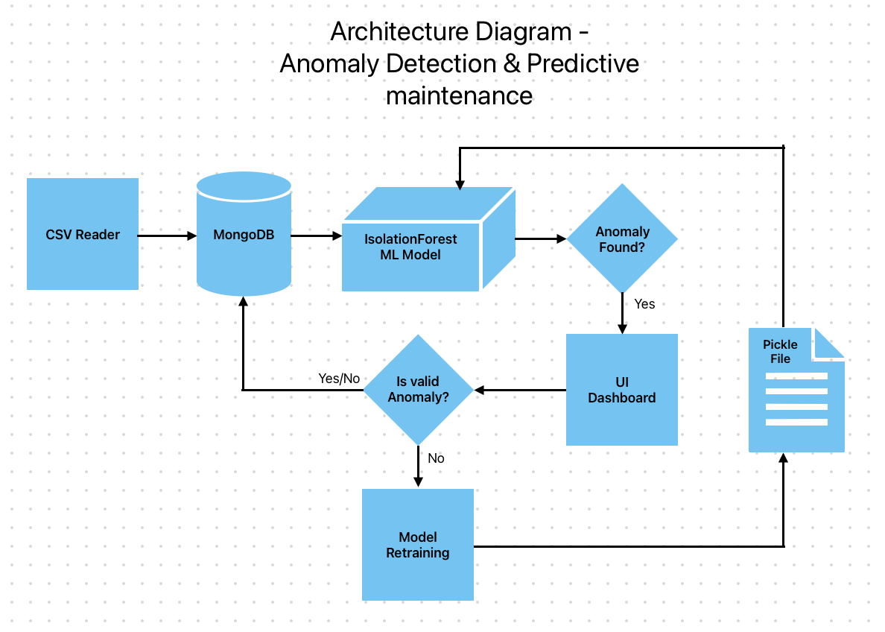
Architecture Overview

Slide 5
Data Pipeline
Sensors send real-time readings.
Preprocessing & feature extraction.
AI/ML anomaly detection.
Alerts with anomaly scores generated.
Human review via HITL dashboard.
Feedback sent to backend → stored in database.
Continuous improvement and retraining. Visual: Arrow flow diagram with sensors, AI model, dashboard, and DB.

Slide 6
AI / ML Anomaly Detection
Multi-sensor input: temperature, vibration, pressure.
Detects spikes or unusual patterns.
Outputs anomaly_score & severity.
Optional: explainable AI via /explain API. Visual: ML model icon with sensor inputs and anomaly outputs.

Slide 7
Backend APIs & Storage
/explain → Returns recommendations for anomalies.
/feedback → Stores human-validated decisions.
MongoDB / SQL / CSV storage of all sensor readings & decisions.
Supports retraining AI models using historical data. Visual: API server icon with arrows to DB & dashboard.

Slide 8
HITL Dashboard Features
Visualize multi-sensor data trends.
Review pending anomalies → Approve / Reject.
View recommendations & anomaly scores.
Dashboard interacts with backend APIs for real-time updates. Visual: Screenshot or mockup of the Streamlit dashboard.

Slide 9
System Benefits
Reduced unplanned downtime.
Faster anomaly detection & response.
Integrates automated AI alerts with human expertise.
Continuous learning & improvement.
Scalable to multiple machines and factories.

Slide 10
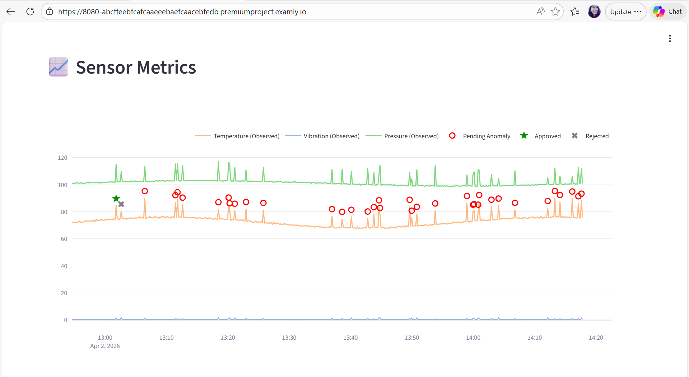
HITL Predictive Maintenance Dashboard

Slide 11
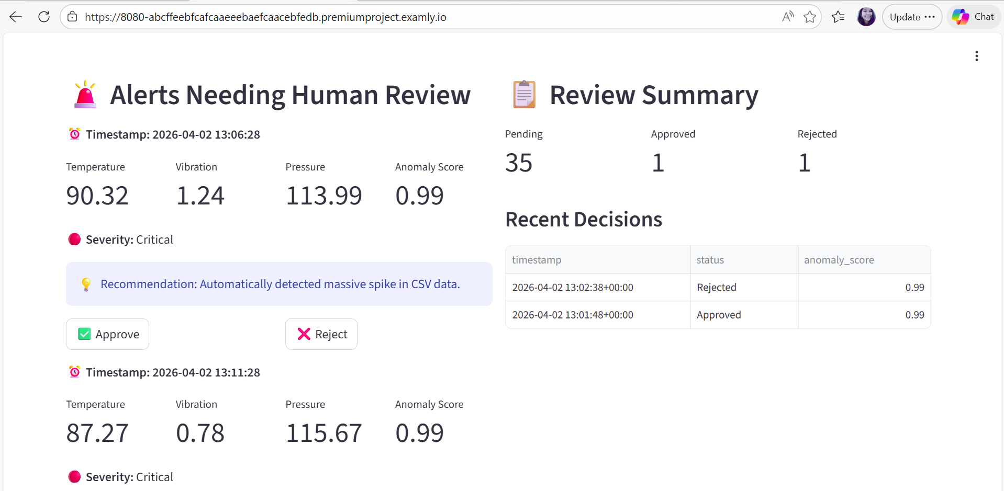
Alerts Needing Human Review

Slide 12
End-to-End Industrial IoT Monitoring & HITL Dashboard

